Slide 1
The structured programming theorem

Slide 2
Outline
In this lesson, we will:
  Review theorems from secondary school
  Review the statements we have seen to this point
  Look at programs using goto statement
  Describe some solvable and unsolvable problems
  Present the structured programming theorem
  Discuss how to use the structured programming theorem when writing programs to solve problems

Slide 3
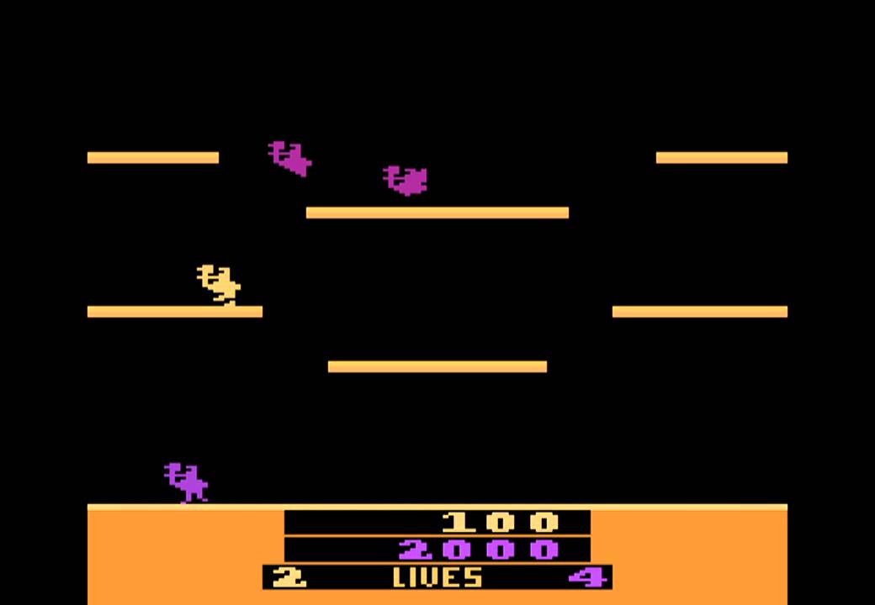

Background
You’ve seen used and observed numerous applications, some of which may amaze you
  You ask yourself, how can you do something like this?
  The answer: Libraries and the structured programming theorem
Joust, Williams Electronics
Fortnite, Epic Games

Slide 4
Background
The C++ language is very complex, and for many and good reasons
  There are many features designed to support the development of software
  The C++ standard costs 198 Swiss Francs (~400 cad) and is over 1600 pages
  Most of you will never master the entire language
    That’s okay, no instructor has, either…

Slide 5
Background
In your mathematics courses, you have seen a few theorems:
  A theorem is a statement must be true if the given premises are true
Examples:
  Euclid’s theorem
  There are infinitely many prime numbers
  The Pythagorean theorem
  If a, b, and c are sides of a right-angled triangle, and c is the side opposite the right angle, then a² + b² = c²
  The remainder theorem
  If a polynomial p(x) is divided by (x – r) , the remainder is p(r)
  The factor theorem
  A polynomial p(x) has a factor (x – r) if and only if p(r) = 0

Slide 6
The flow charts so far
To this point, we have described:
  Conditional statements
  Repetition statements
    For loops and while loops
You may be aware of:
  Functions
  Arrays
  Object-oriented programming

Slide 7
Equivalent implementations
You may be aware of the goto statement
  It exists in C++
start: if ( capacity == 0 ) {
return;
}
int n{0};
int k{1};
double max{array[0]};
next: if ( k == capacity ) {
array[k - 1] = max;
capacity = n;
goto start;
}
if ( max < array[k] ) {
array[k - 1] = max;
max = array[k];
} else {
array[k - 1] = array[k];
n = k;
}
++k;
goto next;
while ( capacity > 0 ) {
int n{0};
int k{1};
double max{array[0]};
while ( k < capacity ) {
if ( max < array[k] ) {
array[k - 1] = max;
max = array[k];
} else {
array[k - 1] = array[k];
n = k;
}
++k;
}
array[k - 1] = max;
capacity = n;
}

Slide 8
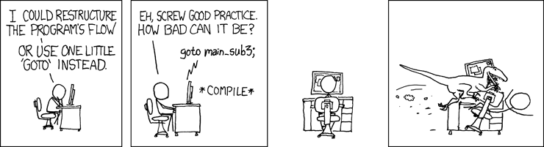
It’s rocket science…
Even the Jet Propulsion Laboratory (jpl) has included this rule:
Rule 11 (simple control flow)
The goto statement shall not be used.

Slide 9
Solvable problems
What problems can be solved?
  Finding the least expensive path between two locations
  Given a set of packages with given volumes, masses, and profit, and given a truck that can hold a fixed mass and volume,
  what is the optimal selection of packages to carry?
  In visiting n cities,
  what is the least expensive sequence in which to visit them?
  Given n integers,
  is there a subset of these integers that sum to zero?
  Given n people of which everyone is known to someone else, but no one is known to everyone,
  what is the smallest subset of these people so that everyone knows at least one person this subset?

Slide 10
Unsolvable problems
What problems cannot be solved?
  Given a program with a particular set of inputs,
  will the program go into an infinite loop?
  Sometimes the answer is obvious:
      int main() {
      int n{};
      std::cin >> n;
      int sum{0};
      for ( int k{0}; k < 10; k += n ) {
      sum += k;
      }
      std::cout << sum << std::endl;
      return 0;
      }

Slide 11
The structured programming theorem
Fortunately, the following theorem says we don’t need any more:
  Any program that can be written can be written using conditional and repetition statements

Slide 12
The structured programming theorem
Consequences:
  You understand most of the tools already
  When you learn a new programming language,
  first understand how to write:
    Conditional statements
    While loops
For example, consider Matlab
if n > 0 while n > 0 for k = 1:10
% do something % do something % do something
end end end
When you tackle a problem that require the repetition of a given set of operations, think in terms of a while loop:
  “We must perform this set of instructions while this condition is true”

Slide 13
Moral of the story…
You will not be required to investigate the structured programming theorem
Use this as a guide to authoring programs:
  Always think in terms of looping while some condition is true
  Understand when you need to terminate the loop
  Always ask Boolean-valued questions,
  either for while loops or conditional statements

Slide 14
Summary
Following this lesson, you now:
  Understand that you should never use a goto statement
  Understand the consequences of the structured programming theorem
    All programs that can be written can be written using only conditional and repetition statements
  When trying to write a program to solve a problem:
    Always think in terms of executing a body of statements if or while some condition is true

Slide 15
References
[1] Wikipedia
https://en.wikipedia.org/wiki/Structured_program_theorem

Slide 16
Acknowledgements
None so far.

Slide 17



Colophon
These slides were prepared using the Georgia typeface. Mathematical equations use Times New Roman, and source code is presented using Consolas.
The photographs of lilacs in bloom appearing on the title slide and accenting the top of each other slide were taken at the Royal Botanical Gardens on May 27, 2018 by Douglas Wilhelm Harder. Please see
https://www.rbg.ca/
for more information.

Slide 18
Disclaimer
These slides are provided for the ece 150 Fundamentals of Programming course taught at the University of Waterloo. The material in it reflects the authors’ best judgment in light of the information available to them at the time of preparation. Any reliance on these course slides by any party for any other purpose are the responsibility of such parties. The authors accept no responsibility for damages, if any, suffered by any party as a result of decisions made or actions based on these course slides for any other purpose than that for which it was intended.

